Slide 1
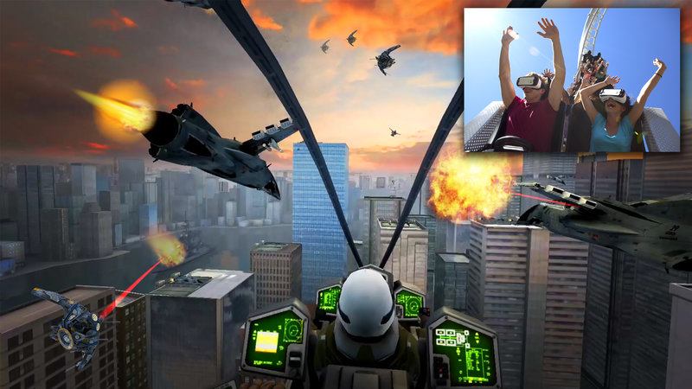
Virtual Reality Augmented Reality
IT 467
Jianwei Lai
Notes:
https://www.youtube.com/watch?v=ihKUoZxNClA
https://www.npr.org/sections/alltechconsidered/2016/08/22/490895637/on-six-flags-virtual-reality-coaster-the-ride-is-just-half-the-thrill

Slide 2
Virtual Reality in Video Gaming
https://www.youtube.com/watch?v=zes95N87mrs
3:20

Slide 3
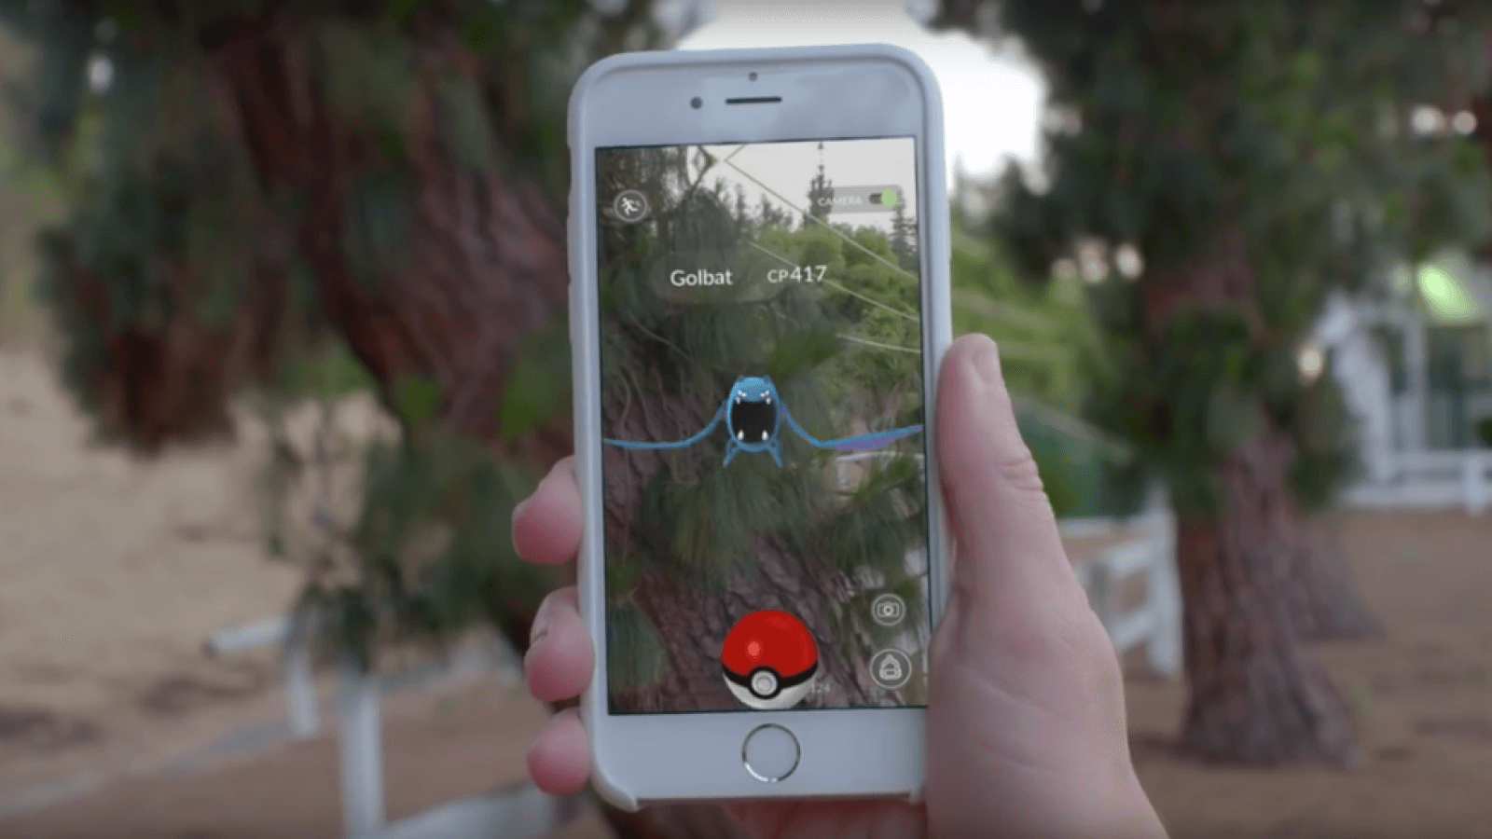
Pokémon Go

Slide 4
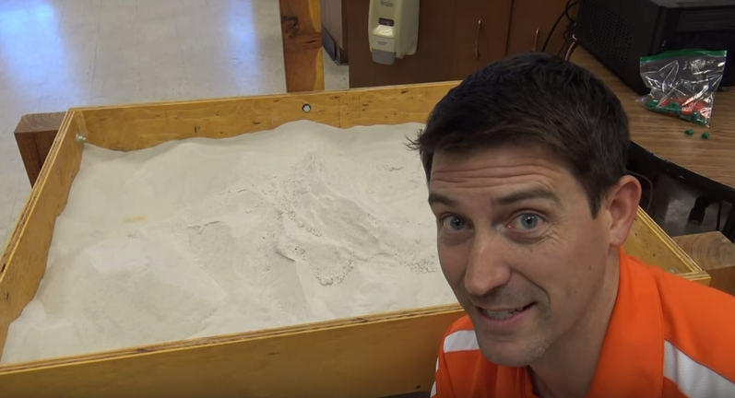
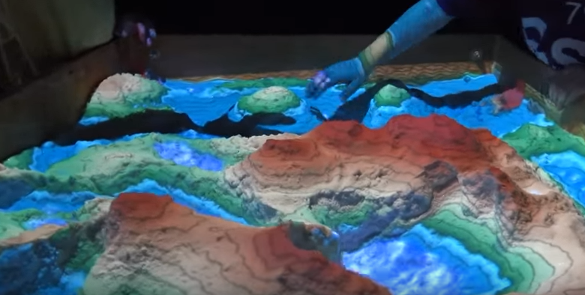
A Cool Sandbox-Not sure if it is real augmented reality
https://www.youtube.com/watch?v=bA4uvkAStPc
Notes:
Not sure if it is real augmented reality

Slide 5
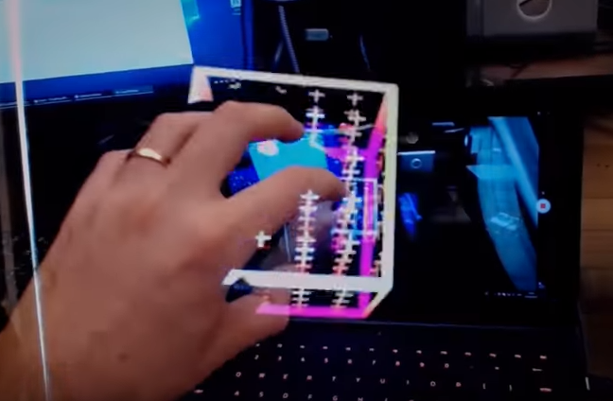
Project North Star: Exploring Augmented Reality
https://www.youtube.com/watch?v=7m6J8W6Ib4w

Slide 6

https://campaignsoftheworld.com/technology/7-technology-trends-shaping-the-future-of-society/
Notes:
Pokémon Go

Slide 7
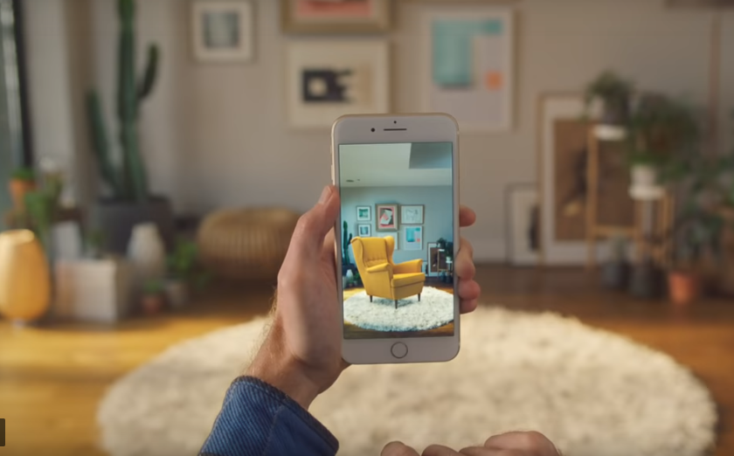
IKEA Place app lets customers see exactly how more than 2,000 furniture items would look – and fit – in their homes
https://www.youtube.com/watch?v=UudV1VdFtuQ

Slide 8
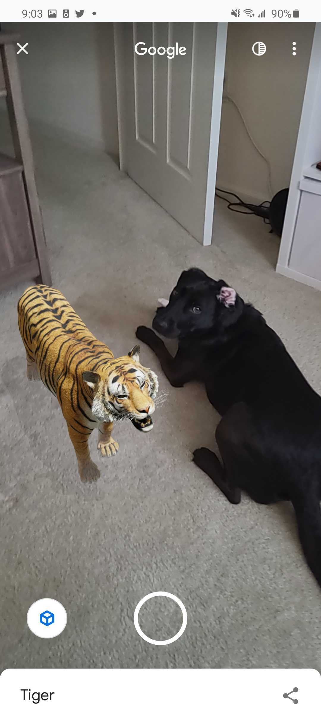
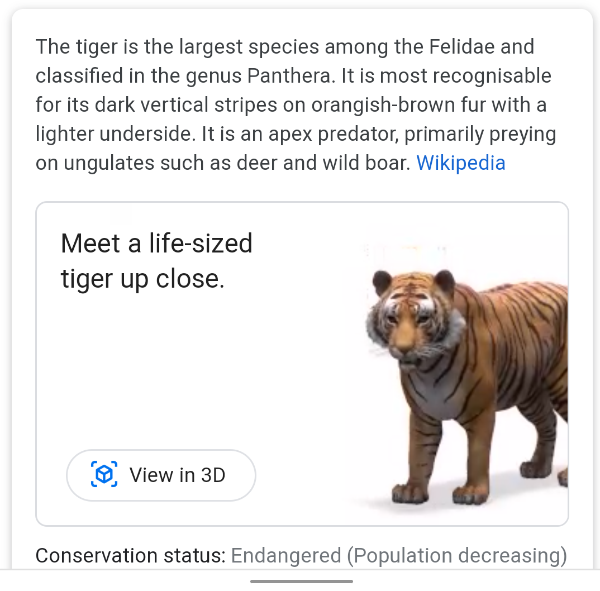
Search an animal on your phone, and choose “View in 3D”-> View in your space
https://9to5google.com/2021/10/16/google-3d-animals-list/

Slide 9
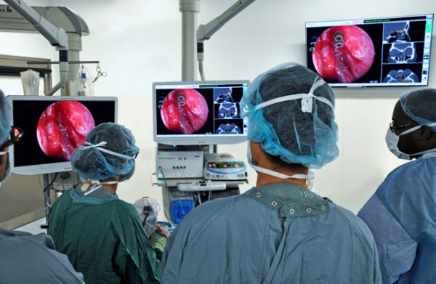
MUHC Takes Augmented Reality into the Operating Room
Notes:
https://publications.mcgill.ca/medenews/2017/06/01/muhc-takes-augmented-reality-into-the-operating-room/

Slide 10
Virtual Reality in Medical Education
https://www.youtube.com/watch?v=7C7zAXf2EI0&t=107s
https://www.youtube.com/watch?v=AttXbcLUyR0

Slide 11
Therapists Are Using VR Headsets to Cure Phobias (HBO)
https://www.youtube.com/watch?v=GMttQHMjbJo

Slide 12
Treating PTSD With Virtual Reality Therapy: A Way to Heal Trauma
https://www.youtube.com/watch?v=QCCWH_CNjM0

Slide 13
Virtual Reality & Augmented Reality
Virtual reality refers to computer-generated environments or realities that are designed to simulate a person’s physical presence in a specific environment that is designed to feel real.
Augmented reality combines real and computer-based scenes and images to deliver a unified but enhanced view of the world.
https://www.techopedia.com/definition/4776/augmented-reality-ar

Slide 14
Hologram- A three –D image formed by the interference of light beam from a laser.
https://www.youtube.com/watch?v=IuNj_rqx04o

Slide 15
Designing Usable 3D UIs
As a serious topic in HCI, 3D interaction has not been around very long.
There is no standard 3D UI (and it's not clear that there could be, given the diversity of input devices, displays, and interaction techniques), and few well-established guidelines for 3D UI design.
While general HCI principles such as Nielsen's heuristics (Nielsen & Molich, 1990) still apply, they are not sufficient for understanding how to design a usable 3D UI.
Notes:
https://www.interaction-design.org/literature/book/the-encyclopedia-of-human-computer-interaction-2nd-ed/3d-user-interfaces#

Slide 16
Unity
Unity is a cross-platform game engine developed by Unity Technologies.
First announced and released in June 2005 at Apple Inc.'s Worldwide Developers Conference as an OS X-exclusive game engine.
https://unity3d.com/get-unity/download

Slide 17
Articles about 3D interface
https://www.interaction-design.org/literature/book/the-encyclopedia-of-human-computer-interaction-2nd-ed/3d-user-interfaces
https://hackernoon.com/behold-the-next-generation-vr-technology-part-4-physical-world-mapping-a16a6f3ad99d

Slide 18
For the rest of the semester
Individual assignment8-wireframe 2 file and link due (Nov. 28)
Optional lab class on Monday (Nov. 28)-If you need any help with your project, please come to the class
Exam 2 on Wednesday (Nov. 30)
Final project and user testing (Dec. 5 & 7) on Zoom
Present your final project and the results of your usability testing in week 16. Let me know if you have a preferred dates (Dec. 5 & 7) by Nov. 28. Otherwise, I will randomly assign you a date.
For your presentation, you will have around 6 minutes to do a quick demo of your own design and present your major findings from the user testing. Given the time limit, you do not have to go through all the questions in your tests. You can prepare a few slides if you prefer.
Optional up to 4 extra points –(Dec. 7)

